Slide 1

Poker Texas Hold’em using Maude
Antinori Alessandro
Coltrinari Riccardo
Scarpetta Marco
Fundamentals of Reactive Systems
A.Y. 2020-2021

Slide 2
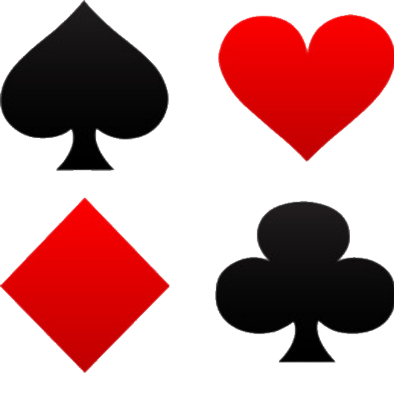
Texas Hold’em in brief
One of the most popular variants of the card game of poker.
Two cards are distributed face down to each player
Five cards are distributed face up in three stages (flop, turn, river)
Each player seeks the best five cards from any combination of the seven cards
Players have betting options to check, call, raise, or fold
Rounds of betting take place before the flop is dealt and after each stage
The player who has the best hand ( and has not folded ) wins

Slide 3

Goal
How to design this poker game in Maude?
How can we represent a player's hand to determine the winner?
How can we simulate a game between two players?
How can we use the rewriting rule for the betting phase?

Slide 4
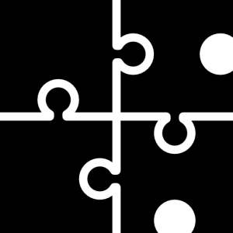
Design
The project is divided into several functional modules.
It allows for a separation of responsibilities and easier reading.
Bottom-Up approach ( from the simple Card module to the Poker system module ).

Slide 5
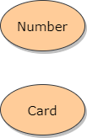
Design - Modules Relation

Slide 6
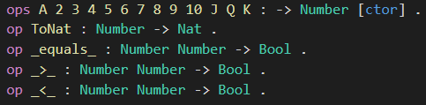
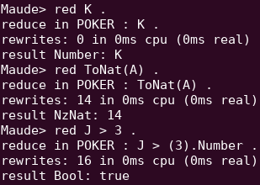
Card Number Module
Designed to represent the number of a card (from 2 to A).
The equal, greater than and less than operators have been redefined in order to compare two cards number.
There is also an operator to obtain a Nat from a Number ( K = 13 ).

Slide 7
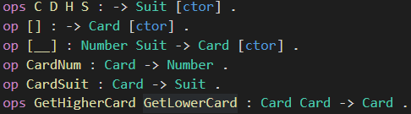
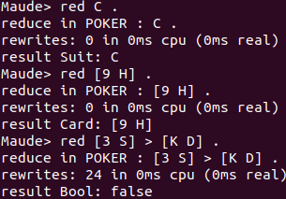
Card Module
Designed to represent the card including the suit (clubs, diamonds, hearts, spades).
The equal, greater than and less than operators have been redefined in order to compare two cards.
This module has utility operators to get the number and the suit of a card.

Slide 8
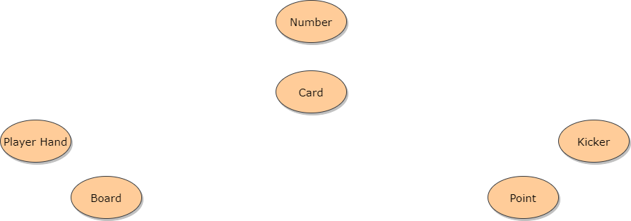
Design - Modules Relation

Slide 9
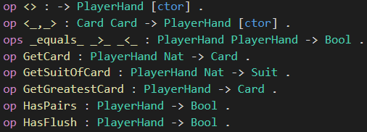
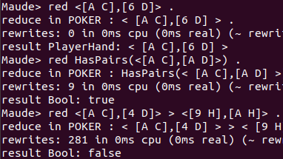
Player Hand Module
Created to represent the two cards of a player .
The order relation operators have been redefined in order to compare two player hands.
There are also operators to get the card number or the suit of the two cards and operations to check for pair/flush.

Slide 10
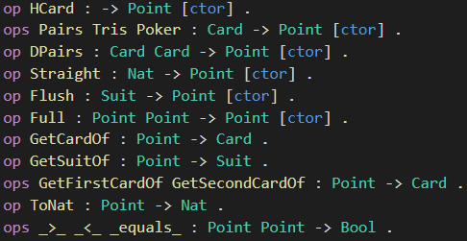
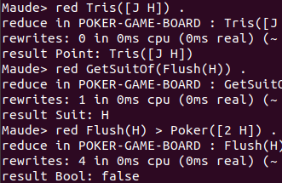
Point Module
Represents the final point that a certain Player can have.
The main operators are the order relations (>, <, equals) and ToNat (assigns lower value for HCard, higher for Poker) .
They are useful to compare two Points and determine the winner.
There are also utility operators to get the card/suit representing the Point itself.

Slide 11
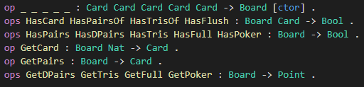
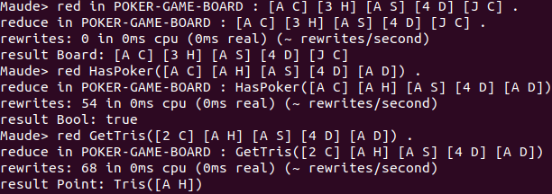
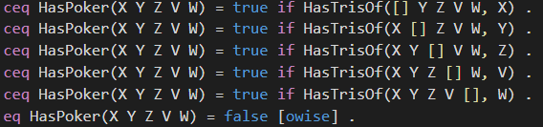
Board Module
Created to represent the board of the game ( five cards ).
There are operators to check if a certain Point is present on the board and to retrieve the card(s) representing the Point itself.

Slide 12
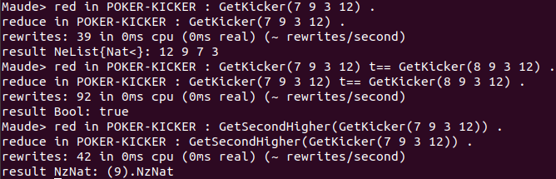
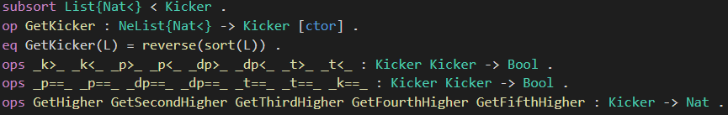
Kicker Module
Represents the kicker that a certain Player can have, based on the point scored.
The kicker is composed by those cards, from the Player Hand and the Board, that are not part of the Point scored.
There are different order relations that permit to compare 2 Kickers depending on the scored Point and decide which one is higher.
The comparison will have to be done whenever 2 Points are equals.

Slide 13
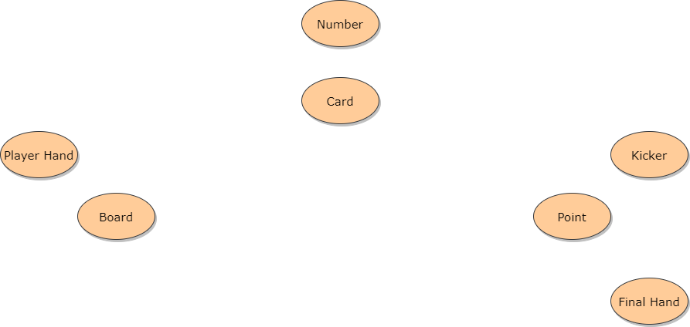
Design - Modules Relation

Slide 14

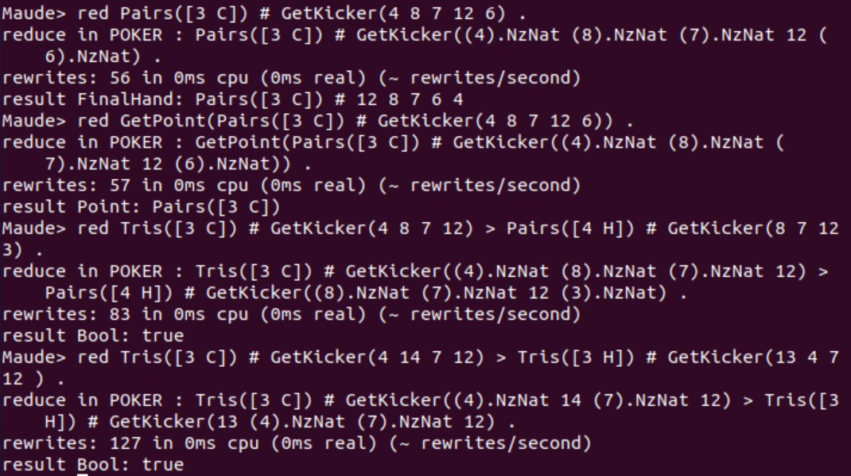
Final Hand Module
A Final Hand is composed by a Point and a Kicker.
It is used to simplify the future operations that will permit to evaluate the best hand.
For each Player we will just have to calculate their Final Hands and then compare the latter to know which is the best, still using the > and < operators.

Slide 15
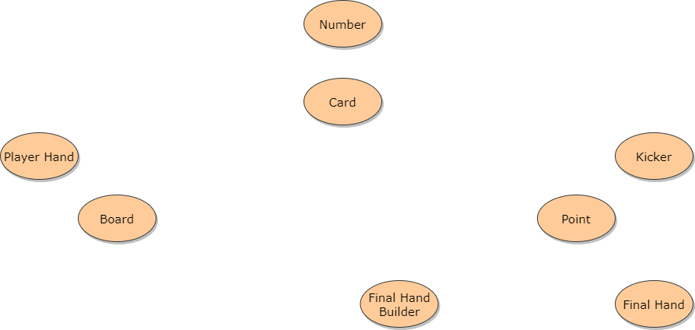
Design - Modules Relation

Slide 16


Final Hand Builder Module
In order to create a Final Hand we need to take a Player Hand and a Board as input, and then calculate the Point scored and the Kicker.
To do that it makes use of 2 modules that help making calculations:
Point Calculator
Kicker Calculator

Slide 17
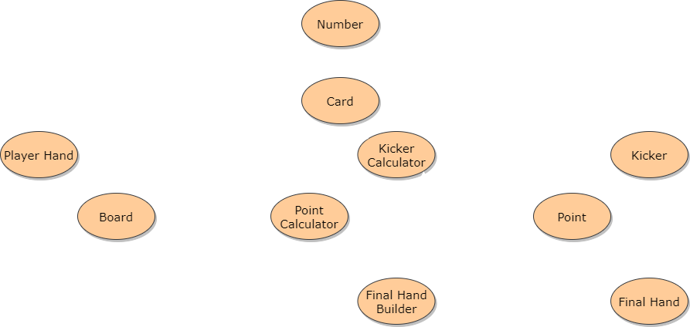
Design - Modules Relation

Slide 18
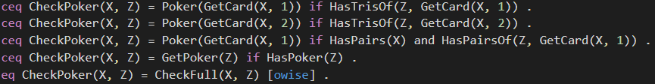

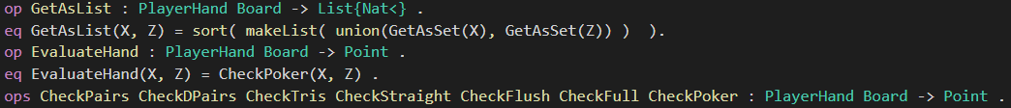
Point Calculator Module
Calculate the Point scored from a Player Hand and a Board.
It is defined to calculate the Point in a top-down manner, from the higher to the lowest possible Point.
We start to check if a Poker has been scored and, if not, we check the next Point (Full), until we reach the lowest possible Point (High Card).

Slide 19
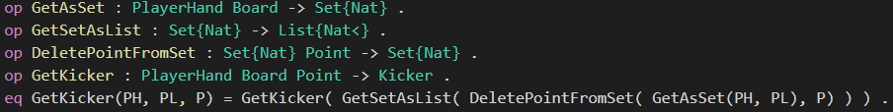

Kicker Calculator Module
Gets a Kicker from a Board, a Player Hand and the Point scored.
Both the Board and the Player Hand are pushed into a set in order to get rid of repeated cards (cards with same Number).
Then the cards that form the Point are discarded.
Finally the set is transformed into an ordered list from the highest to the lowest card.

Slide 20
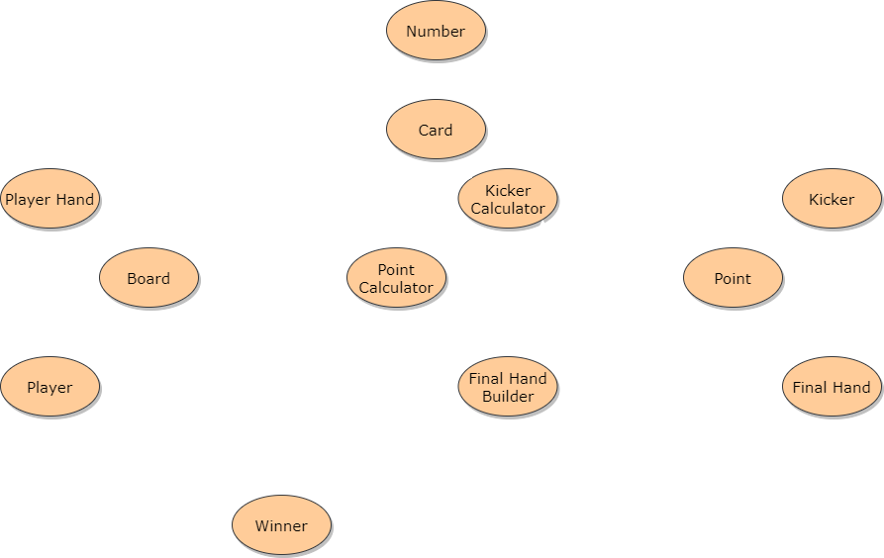
Design - Modules Relation

Slide 21
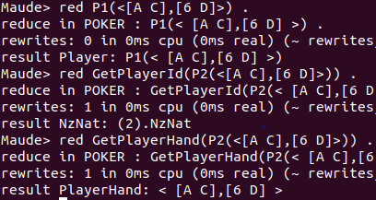

Player Module
Created to represent two players, P1 and P2.
A Player simply consists of a PlayerHand.
There are operations to get the Id or the PlayerHand of a Player and to check if it has a Pair.

Slide 22
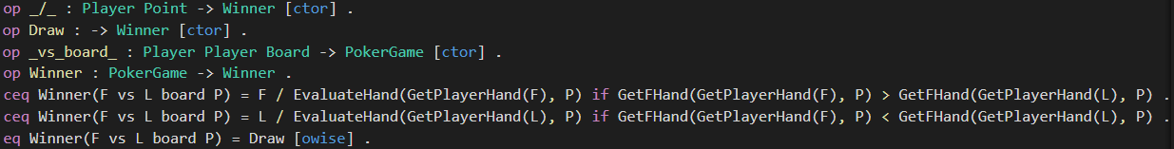
Winner Module
Defines a Winner that could be either a Player or a Draw.
Here is also defined the function that given 2 Players and a Board tells which Player won the game or if its a Draw.
This is done by checking which one of the 2 Players has the best hand, using the > and < operators of the Final Hand.

Slide 23
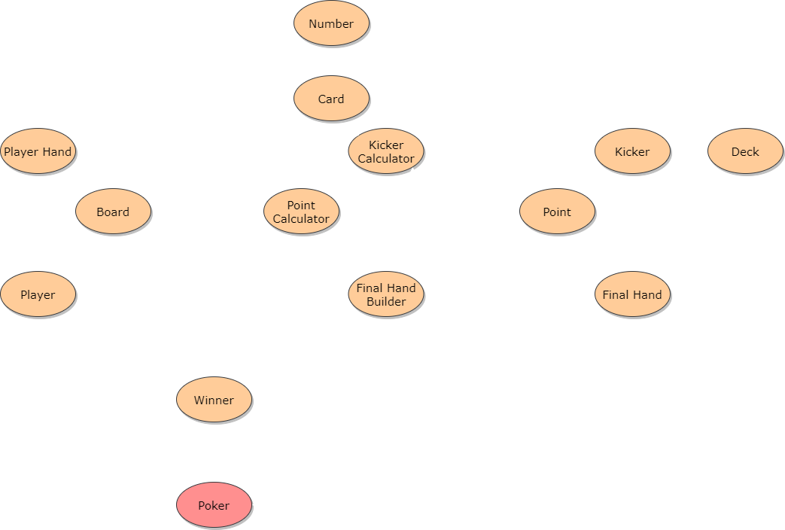
Design - Modules Relation

Slide 24
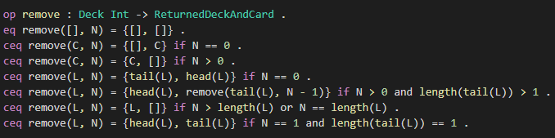
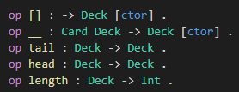
Deck Module (1/2)
This module was created to represent a deck of card constructed from cards by induction ( _ _ operator).
The deck module thus created provides some useful operators to get information on the deck, such as the length, or to modify it, via the remove operator.
The remove operator was implemented for all possible cases (e.g. remove a card from an empty deck, from a deck with a single card, from a generic deck), since a card can be removed from every possible index.

Slide 25
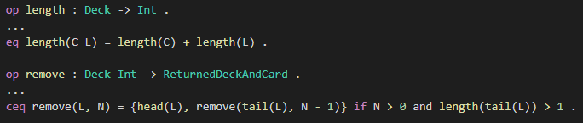
Deck Module (2/2)
For the previous reasons and for the fact that the deck has been constructed by induction, operators such as length or remove present some recursive definition.
As for the remove operator, the return type is a Maude sort that we called ReturnedDeckAndCard, that is able to retain information such as the new deck without a card and the removed card itself.
This let us draw a card from the deck, update the deck and put the removed card in a player’s hand or on the board.

Slide 26
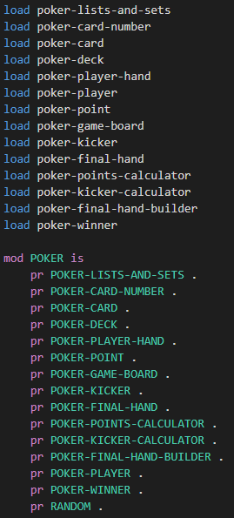
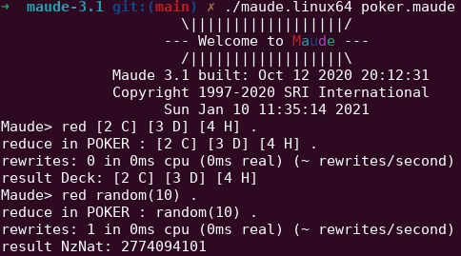
Poker Module
For our project, we wrote a .maude file for each module and we created a poker.maude system module to load all the modules needed via the load keyword and import them via the protecting keyword.
The poker.maude module also contains all the operators and rules needed to make the game evolve.

Slide 27
States and Rules
Cards To P2 Rule
Turn Rule
Winner Rule
Initial state
Cards to P1
Cards to P2
Flop
Turn
River
Winner
Cards To P1 Rule
Flop Rule
River Rule

Slide 28

State and Rewriting Logic in Poker (1/2)
In Maude, unconditional (rl) and conditional rules (crl) make the system evolve, going from a state S_{n} to a state S_{m} such that S_{n} and S_{m} are terms of the same kind. That’s why, in order to simulate a Poker round, we had to consider each step as a term belonging to the same sort.
In our case, during each step, the state of the game is given by the Board, the Players, the Deck and optionally by the Pot and the Winner.

Slide 29
State and Rewriting Logic in Poker (2/2)
We then proceeded to write all the needed operators, equations and conditional rules.
For each transition between states we defined something like this:
so that we are able to separate the equations that will change the variables that make up the state from the conditions that allow for these changes.

Slide 30
Random Module (1/2)
In order to remove a card randomly from the deck each time a card is drawn, we made use of the Random Maude module.
Doing things this way, we implemented the following draw operator:
Normally, calling random(x) with the same value of x generates the same number, but each time a card is drawn, it is removed from the deck, thus decreasing the deck’s length and allowing for a different index of the card to draw each time we call random.
In addition to that, we had to take the modulo (rem operator) of the number generated by random, since it was in the range [0, 2³²-1] and we had to restrict it to the range [0, length of the deck].

Slide 31
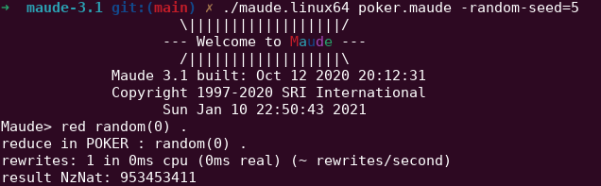
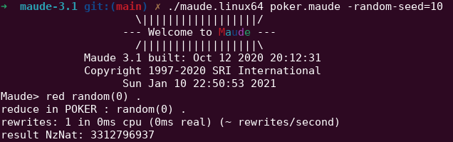
Random Module (2/2)
As we said, all the cards are drawn randomly from the deck, but given the same initial seed (0 in case it is not specified), the sequence of numbers generated by random are always the same.
The poker round can therefore end in only one manner.
One way to avoid this is to use the -random-seed command line option to use a different seed for the random function, in order to simulate different rounds.

Slide 32
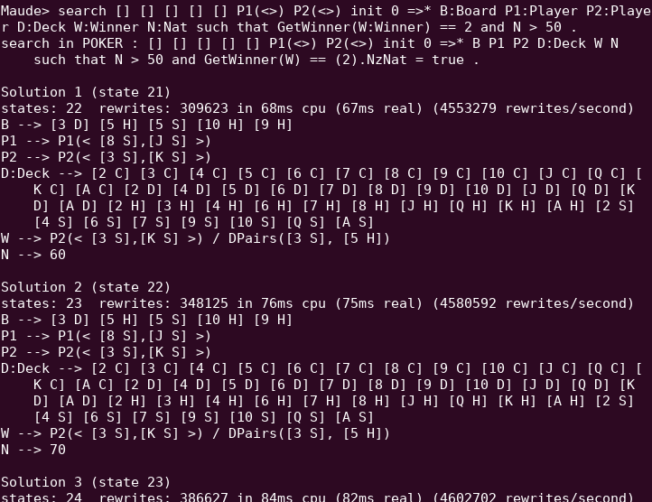
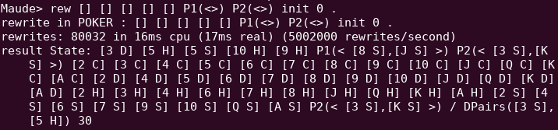
Round example
Now that we have defined all the modules used, we can simulate a round of poker!

Slide 33
That’s All Folks!

